Slide 1
Software Architecture Evolution*
Damian A. Tamburri, Ph.D.
*Slides courtesy of Prof. Dr. Alex Serebrenik@TUe

Slide 2
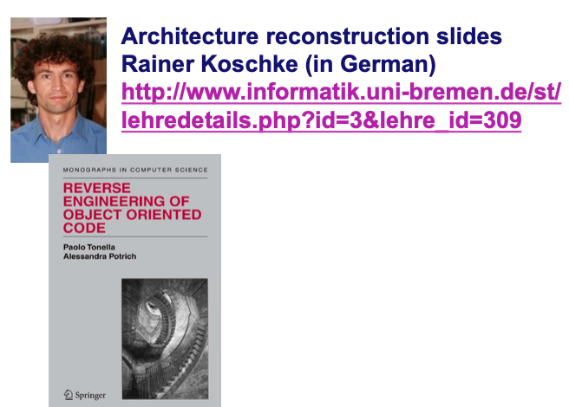
Some Early-set Sources

Slide 3
Why architecture Evolution?
“Good software architecture makes the rest of the project easy.”
Steve McConnell, Survival Guide
“There are two ways of evolving a software design:
one way is to make it so simple that there are obviously no deficiencies;
the other is to make it so complicated that there are no obvious deficiencies.”
C.A.R. Hoare (1985)

Slide 4
The basic problem
Requirements
How do you bridge the gap
between changing requirements
and changing code?
?????
Code

Slide 5
One answer
Requirements
a miracle happens
Code

Slide 6
A better answer
Requirements
Provides a high-level framework to evolve the system
Software Architecture
Code

Slide 7
What does architecture evolution look like?

Slide 8
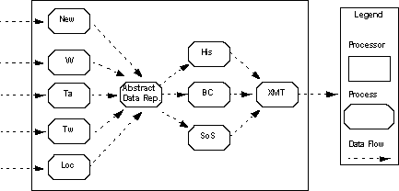

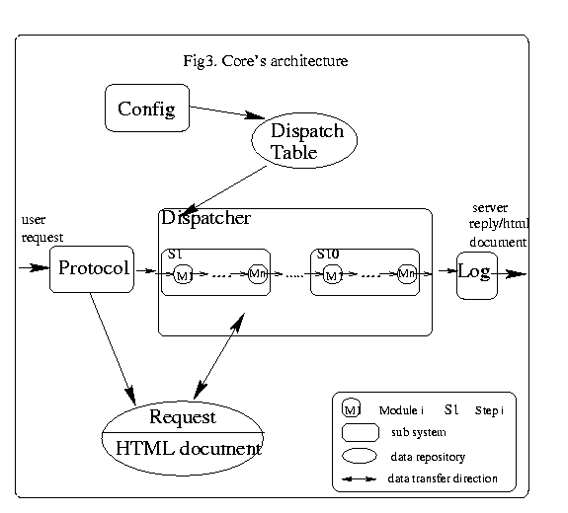
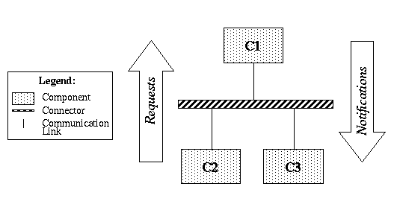
Box-and-arrow diagrams: Before-After Analysis
Very common and hugely valuable.
But, what does a box represent? an arrow? a layer? adjacent boxes?

Slide 9
Evolving architectures: components and connectors
Components evolve the basic computations comprising the system and their behaviors
abstract data types, filters, etc.
Connectors refine the interconnections between components
procedure call, event announcement, asynchronous message sends, etc.
The line between them may be fuzzy at times
Ex: A connector might (de)serialize data, but can it perform other, richer computations?

Slide 10
(UML?) diagrams (may) help
A standardized way to describe (draw) architectures ➔ sharing architectural knowledge & decisions
Also implementation/evolution details such as subclassing, uses (dependences), and much more
Widely used in industry

Slide 11
A good architecture
Satisfies (changing) functional and performance requirements
Manages complexity
Accommodates for future change (including refactoring & evol.)
Is concerned with:
reliability, safety, understandability, compatibility, robustness, …

Slide 12
A good architecture
Satisfies (changing) functional and performance requirements
Manages complexity
Accommodates for future change (including refactoring & evol.)
Is concerned with:
reliability, safety, understandability, compatibility, robustness, …
EVOLVABILITY!

Slide 13
Typical Approach Divide and conquer
Benefits of decomposition:
Decrease size of tasks
Support independent testing and analysis
Separate work assignments
Ease understanding
Use of abstraction leads to modularity
Implementation techniques: information hiding, interfaces
To achieve modularity, you need:
Strong cohesion within a component
Loose coupling between components
And these properties should be true at each level

Slide 14
Architecture Evolution Objectives
++ System understanding: interactions between modules
++ Reuse: high-level view shows opportunity for reuse
++ Construction rationale: breaks development down into work items; provides a path from requirements to code
++ Fast Evolution: high-level views accelerate evolution path
++ Management: helps understand/change work items and track progress/allocate teamwork
++ Communication: provides vocabulary, common understanding; a picture says 1000 words!

Slide 15
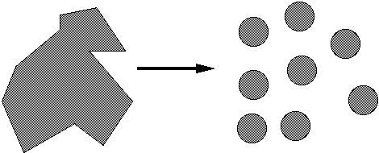
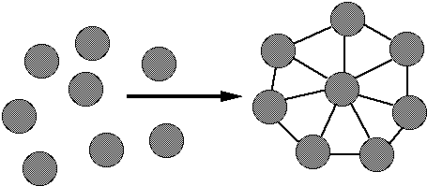
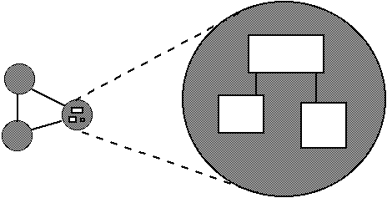
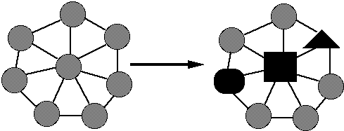
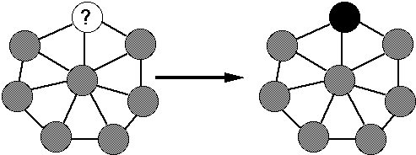
Qualities of well-modularized software archs.
decomposable
can be broken down into pieces
composable
pieces are useful and can be combined
understandable
one piece can be examined in isolation
has continuity
change in reqs affects few modules
protected / safe
an error affects few other modules

Slide 16
Properties of architecture to evolve into
Looser Coupling
Higher Cohesion
Style conformity ➔ conformance checking
Domain Matching
Supply for Erosion (more on this ahead in the course)

Slide 17
Loose coupling
Coupling: the kind and quantity of interconnections among modules
Modules that are loosely coupled (or uncoupled) are better than those that are tightly coupled
The more tightly coupled two modules are, the harder it is to work with them separately
Notes:
Think about testing … to test tightly coupled, need both in place. If not, could test independently.

Slide 18
Tightly or loosely coupled?
Notes:
Think about what would happen if we removed one component. How many modules are affected?

Slide 19
Tightly or loosely coupled?
Notes:
Look at the number of connections between modules

Slide 20
Strong cohesion
Cohesion: how closely the operations in a module are related
Tight relationships improve clarity and understanding
Classes with good abstraction usually have strong cohension
No schizophrenic classes!

Slide 21
Strong or weak cohesion?
class Employee {
public:
…
FullName GetName() const;
Address GetAddress() const;
PhoneNumber GetWorkPhone() const;
…
bool IsJobClassificationValid(JobClassification jobClass);
bool IsZipCodeValid (Address address);
bool IsPhoneNumberValid (PhoneNumber phoneNumber);
…
SqlQuery GetQueryToCreateNewEmployee() const;
SqlQuery GetQueryToModifyEmployee() const;
SqlQuery GetQueryToRetrieveEmployee() const;
…
}
Notes:
No logical connection between employees and routines that check zip codes, etc.
SQL details are lower level and break abstraction

Slide 22
Architectural style
Defines the vocabulary of components and connectors for a family (style)
Constraints on the elements and their combination
Topological constraints (no cycles, register/announce relationships, etc.)
Execution constraints (timing, etc.)
By choosing a style, one gets all the known properties of that style (for any architecture in that style)
Ex: performance, lack of deadlock, ease of making particular classes of changes, etc.

Slide 23
Styles are not just boxes and arrows
Consider pipes & filters, for example (Garlan and Shaw)
Pipes must compute local transformations
Filters must not share state with other filters
There must be no cycles
If these constraints are violated, it’s not a pipe & filter system
One can’t tell this from a picture
One can formalize these constraints
scan
parse
optimize
generate

Slide 24
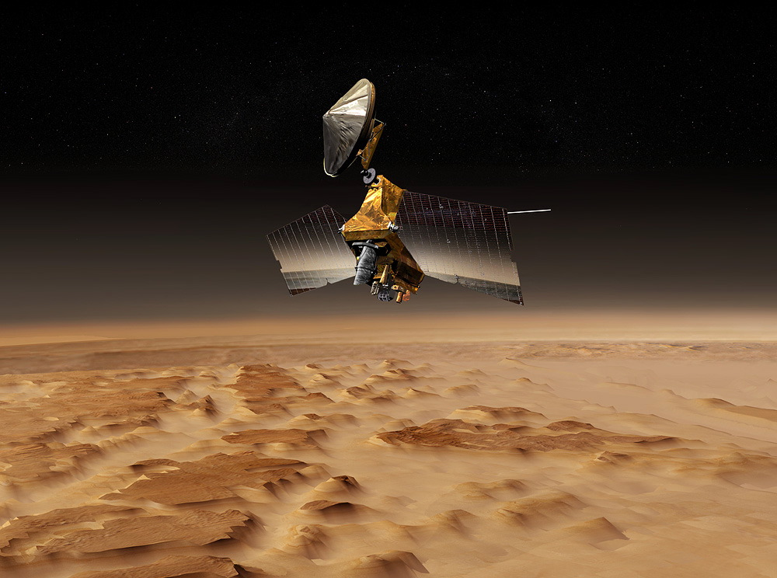
Interface mismatch
Mars orbiter loss
NASA lost a 125 million Mars orbiter because one engineering team used metric units while another used English units for a key spacecraft operation

Slide 25
Architectural mismatch
Garlan, Allen, Ockerbloom tried to build a toolset to support software architecture definition from existing components
OODB (OBST)
graphical user interface toolkit (Interviews)
RPC mechanism (MIG/Mach RPC)
Event-based tool integration mechanism (Softbench)
It went to hell in a handbasket, not because the pieces didn’t work, but because they didn’t fit together
Excessive code size
Poor performance
Needed to modify out-of-the-box components (e.g., memory allocation)
Error-prone construction process
Architectural Mismatch: Why Reuse Is So Hard. IEEE Software 12, 6 (Nov. 1995)
Architecture should warn about such problems (& identify problems)

Slide 26
Views
A view illuminates a set of top-level design decisions
how the system is composed of interacting parts
where are the main pathways of interaction
key properties of the parts
information to allow high-level analysis and appraisal

Slide 27
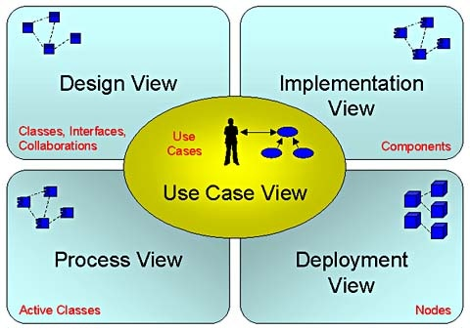
Importance of views
Multiple views are needed to understand the different dimensions of systems
Packaging
Requirements
Functional Requirements
Performance (execution) Requirements
Installation Requirements
Booch
Notes:
Code oriented: Modules, data layers
Implementation: files, BOD, configuration management menu

Slide 28
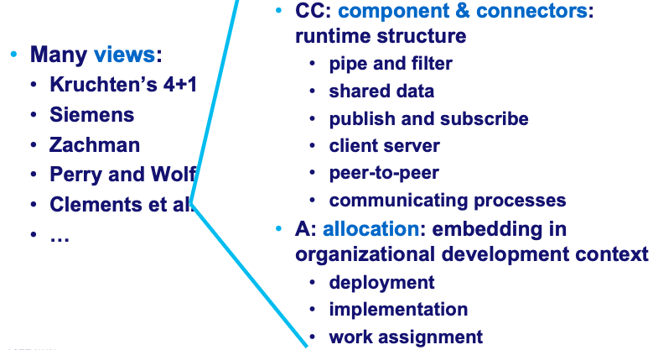
Component Architectures Reimagined

Slide 29
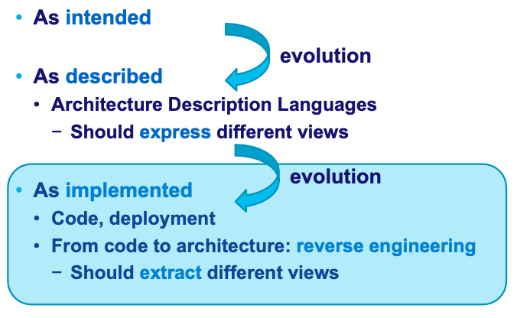
SA’s in general….

Slide 30
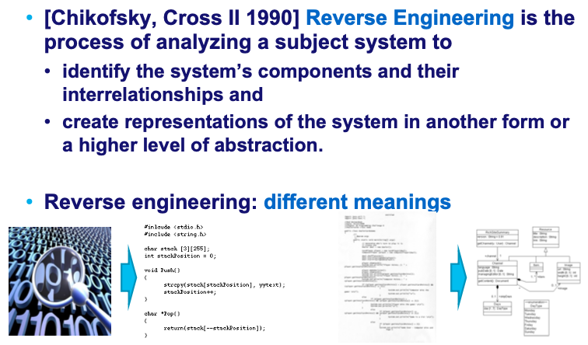
Reverse Engineering (more on this later in the course)

Slide 31
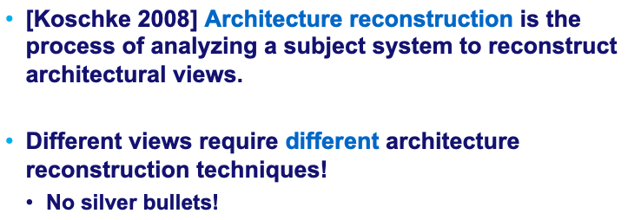
Differently than our Reverse Engineering

Slide 32
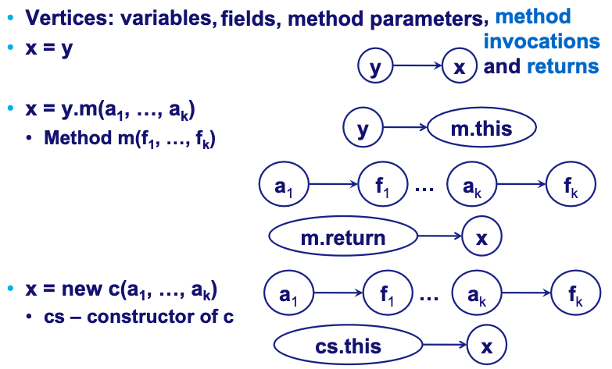
Basic idea: Object Flow Graphs

Slide 33
Basic idea: Object Flow Graphs
Recover the OFG
Reason on possible graph transformations/improvement ➔ refactoring:
Use a design pattern instead of underused classes/functions
Use a different template (in C++)
Improve coupling/cohesion (e.g., using metrics);
…

Slide 34
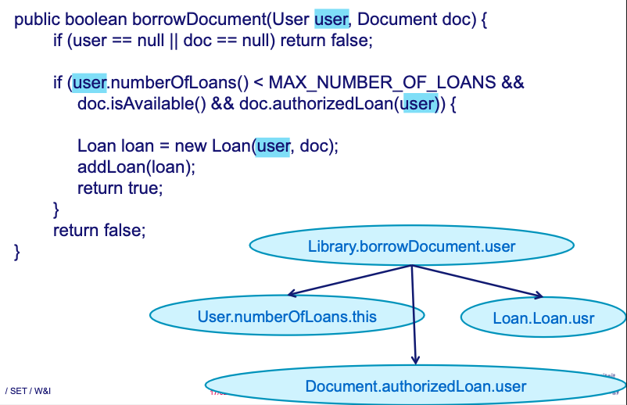

Slide 35
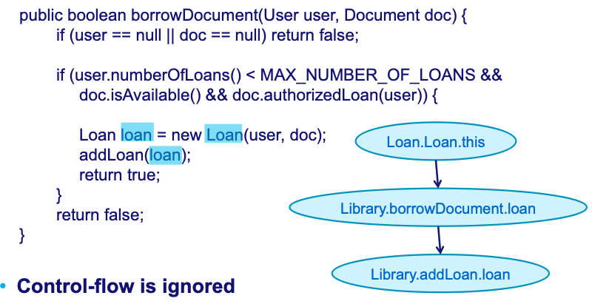

Slide 36
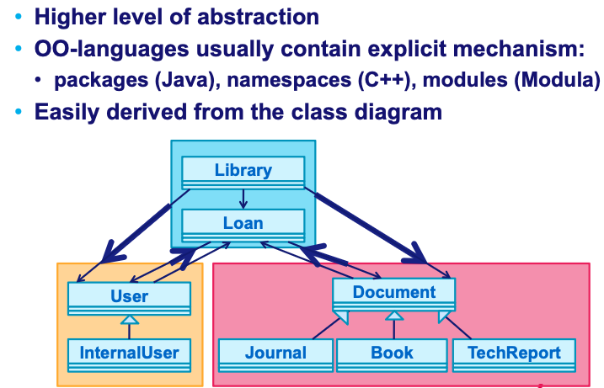
Packages Refactoring

Slide 37
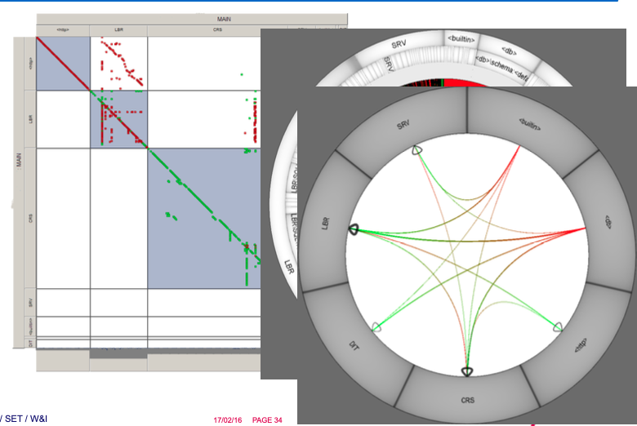

Slide 38
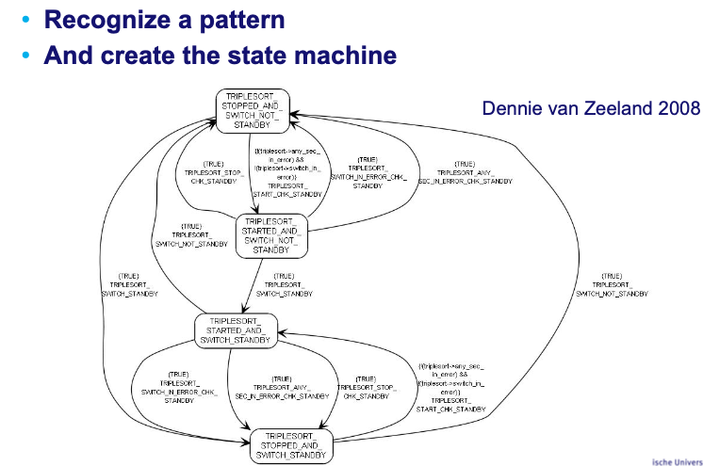
Behavioural Recovery & Evolution

Slide 39
Question: is there a way to automate this s**t?

Slide 40
Self-adaptive software
Self-adaptive software is a software that modifies its own behavior at run-time in response to changes in its operating environment
Definition:
Behavior: anything the software is expected to do
Run-Time: do not need to be shut down to make the change
Changes in operating environment: anything observable by the software system, e.g. end-user input, external hardware devices and sensors, or program instrumentation

Slide 41
Issues for adaptation
What Conditions?
Performance boost, failure recovery, re-configuration
Open or Closed adaptation
Is new application behavior can be added at runtime?
Type of autonomy
Fully autonomic, Self-contained, Human-in-the-loop
Frequency
Opportunistic, continuous, or lazy, as needed
Cost Effectiveness
Benefits should outweigh the cost of adaptation
Information Type and Accuracy

Slide 42
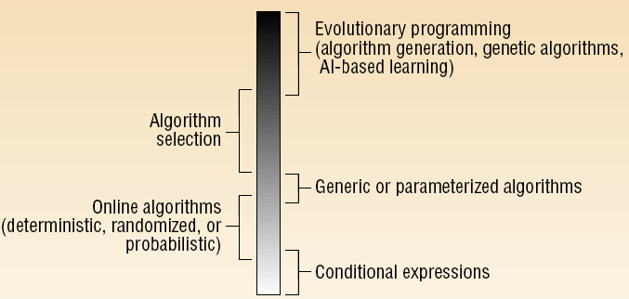
Degrees of adaptability

Slide 43
Conditional expressions
Program evaluates an expression and alters its behavior based on the outcome
E. g. if/switch statements

Slide 44
Online algorithms
assume future events are uncertain
leverage knowledge about the problem and the input domain to improve efficiency
E. g. memory-cache paging algorithm

Slide 45
Generic algorithms
Provide behaviors that are parameterized
E.g. polymorphic type in OOPLs, working with instances of new classes (derived from known classes or implement known interfaces)

Slide 46
Algorithm selection
Selection of the effective algorithm among a fixed set of available algorithms based on environment properties
E. g. Self optimizing compiler uses program-profiling data collected during program execution to select another optimization algorithms

Slide 47
Evolutionary programming
Using properties of the operating environment and knowledge gained from previous execution to generate new algorithms

Slide 48
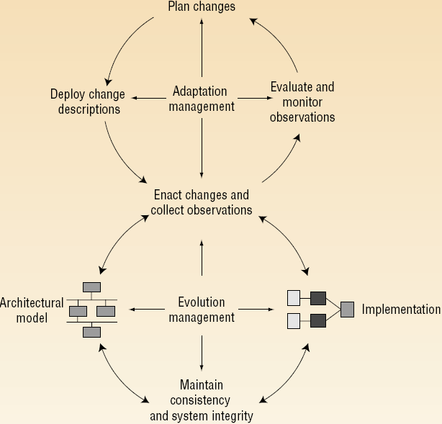
Adaptation methodology

Slide 49
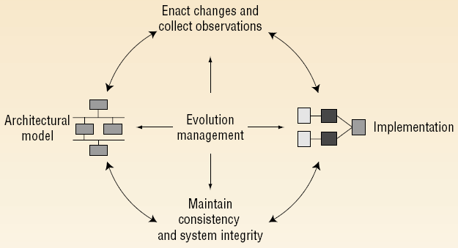
Architectural model

Slide 50
Dynamic software architecture
In dynamic systems: modification in behaviour at run-time by making the following architectural changes:
Adding new components
Removing existing components
Replacing existing components
Changing the connectivity structure between components
Two approaches to dynamism at the architectural level:
C2
Weaves

Slide 51
C2 and Weaves
Both
distinguish between components and connectors
no restriction on their implementation language
communication between components by exchanging asynchronous messages (C2) or objects (Weaves)
all communication between components must be via connectors

Slide 52
C2
System as a hierarchy of concurrent components bound together by connectors
Component is aware of components “above” it and unaware of components residing at the same level or “beneath” it
Communication between a component and those below it is handled implicitly using events
Whenever a component changes its state, it broadcasts this to all components below it
C1
C2
C3
C4
C5
C6
C7

Slide 53
Weaves
Dynamic, objectflow-centric architecture
Components consume objects as inputs and produce objects as outputs
Components do not know the semantics of the connectors that delivered its input objects or transmitted its output objects
C1
Obj1 returns
C2
C3
C4
Obj2

Slide 54
Maintaining consistency

Slide 55
Maintaining consistency and integrity
Preserving an accurate and consistent model of components and connectors
Maintain a strict correspondence between the architectural model and the executing implementation
Architecture Evolution Manager (AEM)
maintains the consistency between architectural model and implementation
prevents changes from violating architectural constraints

Slide 56
Enacting changes

Slide 57
Enacting changes
Possible sources of architectural change
Architecture editor
To construct architecture and describe modifications
With analysis tools such as design analyzer or domain-dependent analyzer
Modification interpreter
Tool to interpret change scripts written in a change-description language to primitive actions supported by the AEM

Slide 58
Adaptation methodology

Slide 59
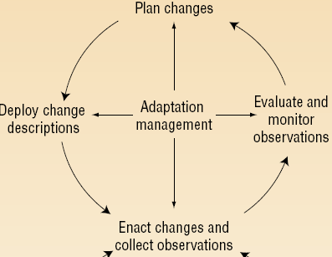
Collecting observations
Varieties of observations: event generation, …
Observers for notification of exceptional events
Expectation agent
detecting and noting single events is not enough
responds to the occurrence of event patterns
New techniques for reducing the monitoring overhead

Slide 60
Evaluate and monitor observations
Adaptive demands arise from inconsistencies or suboptimal behavior
Evaluating and observing an application’s execution, including, performance monitoring, constraint verification, …

Slide 61
Plan changes
The task of accepting the evaluations, defining an appropriate adaptation, and constructing a blueprint for executing that adaptation
Two forms
Observation planning: determines which observations are necessary for deciding
Adaptation planning: determines exactly which adaptations to make and when

Slide 62
Deploy change descriptions
Change descriptions
Included are any new required components or connectors and their affiliated annotations
Interact with the AEM to translates the change in descriptions into specific updates of implementation

Slide 63
Interesting points
Key issues for adaptive software: open-closed, cost effective, ...
Classification of self-adaptability, ranging from conditional expressions to evolutionary programming
Making effort to connect software development process with adaptation process
Does not bode well for CI/CD

Slide 64
Many Things Can Go Wrong
Resource variability
Changing environments
Shifting user needs
System faults
Application or network connection fails
Software Application(s)
Server load changes
Wireless device moves into a different network
User attempts foul-play
The system should dynamically adapt to these problems.

Slide 65
External Adaptation
Global system perspective
Important system-level behaviors and properties
Explicit system integrity constraints
Architectural model &
Adaptation mechanism
adapt
monitor
Software Application(s)

Slide 66
Desirable Solution
Ideally, we’d like a solution that
enables software engineers
to use architectural models
to adapt existing systems
Key Challenge: One size does not fit all
Solution should be
General
cost-effective
composable

Slide 67
Challenges on Support Self-Adaptation
Tight-coupling between application code and adaptation logic
Significant development effort to explicitly model the numerous potential states and paths from one state to a new state.
Trace the self-adaptive requirements to implementation elements

Slide 68
Autonomic Computing
Autonomic computing seeks to improve computing systems with a similar aim of decreasing human involvement.
The term “autonomic” comes from biology.
In the human body, the autonomic nervous system takes care of unconscious reflexes, that is, bodily functions that do not require our attention
The term autonomic computing was first used by IBM in 2001 to describe computing systems that are said to be self-managing.

Slide 69
Autonomic Computing
Autonomic computing aims at providing systems with self-management capabilities
self-configuration (automatic configuration according to a specified policy)
self-optimization (continuous performance monitoring)
self-healing (detecting defects and failures, and taking corrective actions)
self-protection (taking preventive measures and defending against malicious attacks)

Slide 70
Conclusions
Architectural “recovery” more useful during system run time
Efficient, scalable constraint evaluation to do it continuously
Environment modeling and scoping is hard!
Handling multiple models and dimensions of concern
Automated Arch. Evol is possible but:
Reasoning about the correctness of a repair strategyis hard
Non-deterministic arrival of system observations
Avoiding thrashing
Adapting the adaptation strategies

Slide 71

Questions?

